Slide 1
Code search tools
Mihai Todor
29.01.2018

Slide 2
How many Windows developers are here?
Notes:
Show Notepad++ example
Show Visual Studio example

Slide 3
Can we do better?
Non-indexed search tools – rest of this talk
Indexed search tools (offline / online)
Visual Studio (Find all references)
Ctags https://en.wikipedia.org/wiki/Ctags
DXR https://dxr.readthedocs.io/
GitHub https://github.com
searchcode https://searchcode.com/
grepcode http://grepcode.com/

Slide 4

Disclaimer: I’m not a console ninja!

Slide 5

Originally developed for the Unix operating system
Available on most operating systems out of the box
Console-only
Fast
git-grep https://git-scm.com/docs/git-grep
Adopted as a verb / noun: You can't grep dead trees

Slide 6
grep example
grep --include "*.cpp" --include "*.h" --include "*.hpp" --exclude-dir=Libraries -r -n . -i -e "zavinac.*bodka"

Slide 7
Shortcomings
Single threaded
Inconsistent implementations (Linux vs OSX)
Lacks many features (i.e. non-UTF-8 support)
Awkward syntax / file type specifications

Slide 8
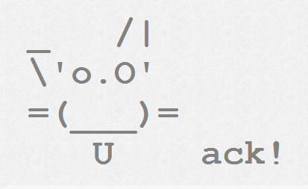

Can we do even better?
https://beyondgrep.com/ (used to be betterthangrep.com)
Written in

Slide 9

The Silver Surfer Searcher
https://github.com/ggreer/the_silver_searcher
Written in C
Uses the PCRE library for RegEx searches
Ignores VCS folders and patterns specified in .gitignore / .ignore
Standardisation of the .ignore file https://news.ycombinator.com/item?id=12567328
Example: ag --ignore "./Libraries/**" --cpp -i "font"

Slide 10

Ripgrep
https://github.com/BurntSushi/ripgrep
ripgrep is faster than {grep, ag, git grep, ucg, pt, sift}
http://blog.burntsushi.net/ripgrep/
Written in Rust
Non-UTF-8 support
ag is UTF-8 only https://github.com/ggreer/the_silver_searcher/issues/914
Example: rg -g "\!Libraries/**" --type cpp -i -n "font"

Slide 11

Other alternatives
Sift https://github.com/svent/sift
The Platinum searcher https://github.com/monochromegane/the_platinum_searcher
Even more: https://beyondgrep.com/more-tools/

Slide 12
Limitations
Console only
Can’t click on files to open them in the editor…
Bummer… Too much manual work to open results in editor and scroll to the result line.

Slide 13
IDE Integrations
VSCode search is powered by ripgrep
https://code.visualstudio.com/updates/v1_11#_text-search-improvements
Let’s write a Visual Studio extension!
https://github.com/mihaitodor/Searcher

Slide 14
Any questions?
Thank you!

